Slide 1

1

Slide 2


Slide 3

3

Slide 4
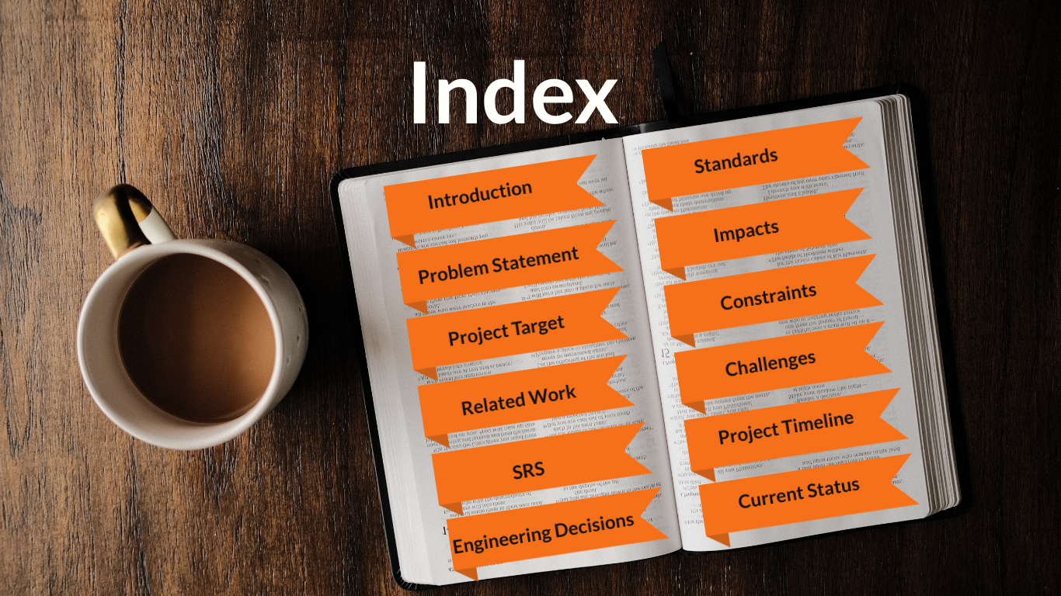

Slide 5
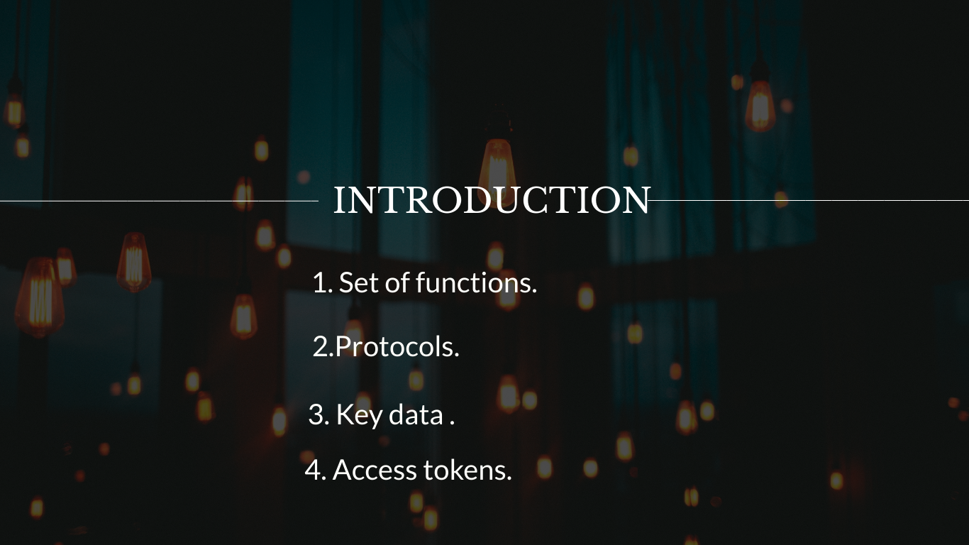

Slide 6
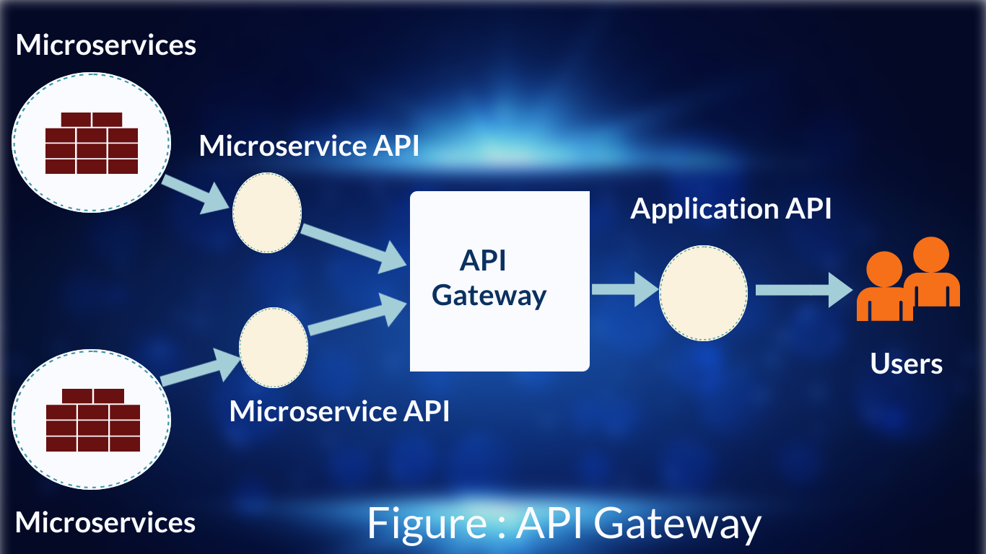
6

Slide 7
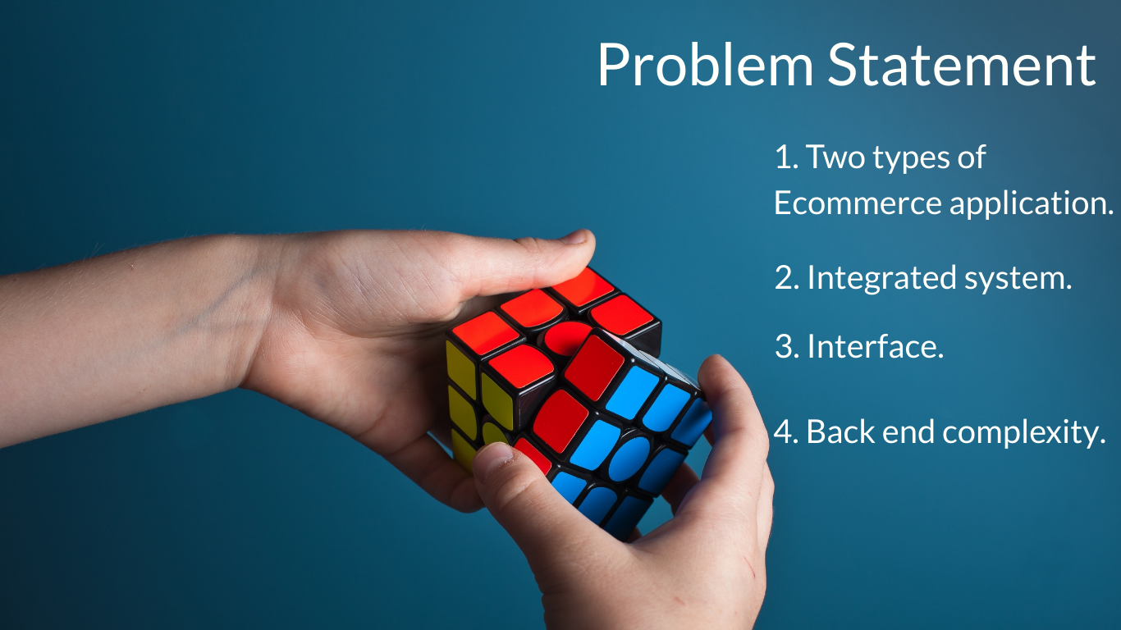

Slide 8
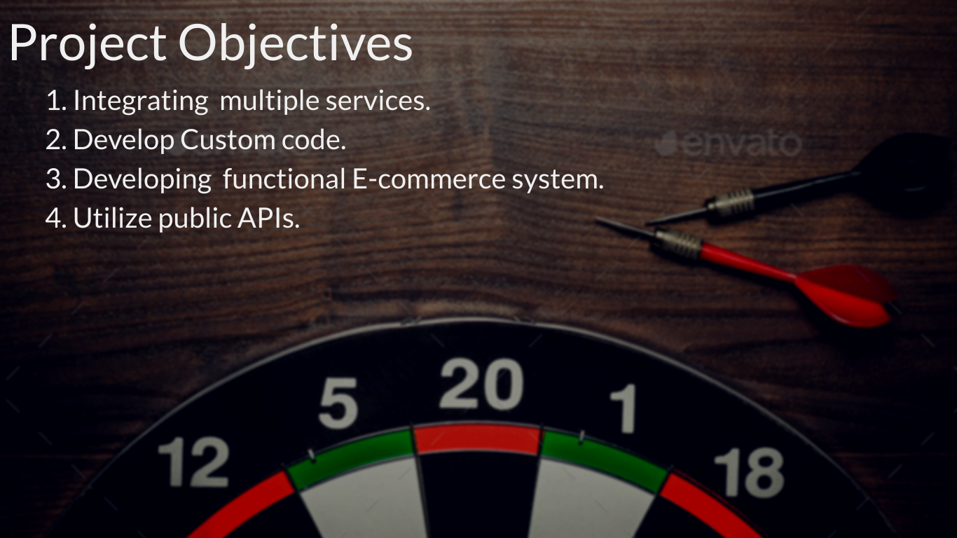
8

Slide 9
Select necessary resources and features
Project Proposal Submission
Exploring shopify platform
Setting up store on shopify
Week
3
Week 4
Week 5
Week 6
Week 7
Week 8
Week 9
Week 10
Gather Resources for project.
Working with JSON
Server setup and test
Implementing features on shopify store
Fig : Time Line Of First Part

Slide 10
Working with the database
Working With Shopify Private Apps
Integrating modules
Testing
Week
3
Week 4
Week 5
Week 6
Week 7
Week 8
Week 9
Week 10
Adding Payment Gateway
Working with the database
Running the app on server side
Documentation
Fig : Time Line Of Second Part

Slide 11
Work Division
Work | Nopa | Sukannya | Ajmaree | Nasir | Prity
Project proposal | √ | √ | √ | √ | √
Preparing slides | √ | √
Study Materials | √ | √ | √ | √ | √
Working with JSON | √ | √ | √ | √ | √
Report writing | √ | √ | √ | √ | √
Implementing Shopify Store | √ | √ | √ | √ | √
Prepare report on Latex |  |  |  |  | √
Record project video |  |  |  | √
Edit Video and upload |  |  |  | √
Server Setup |  |  |  | √
Features Implementation | √ | √ | √ | √ | √

Slide 12
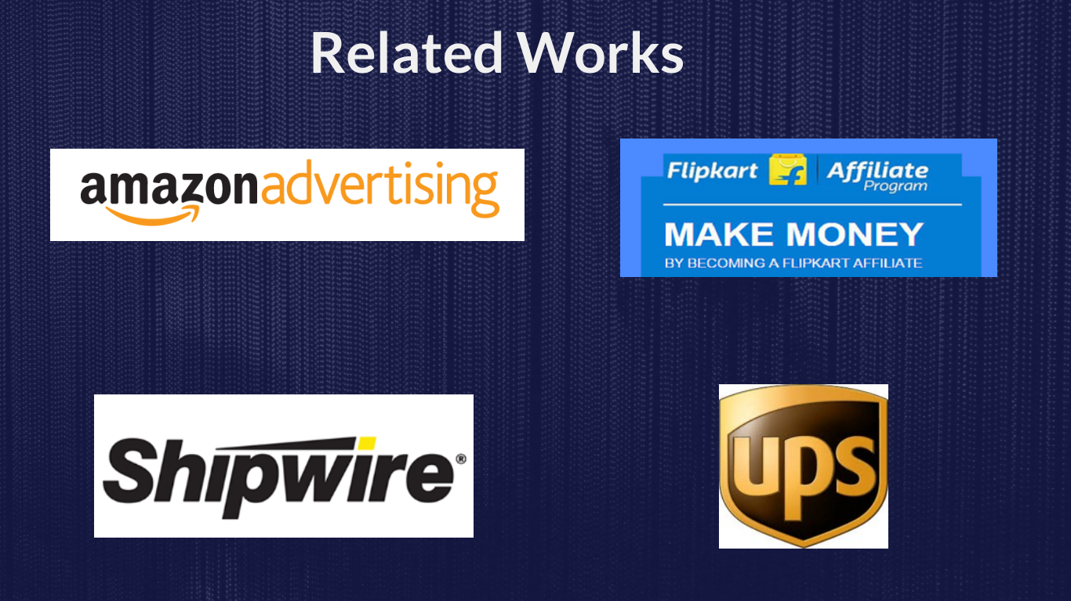
12

Slide 13
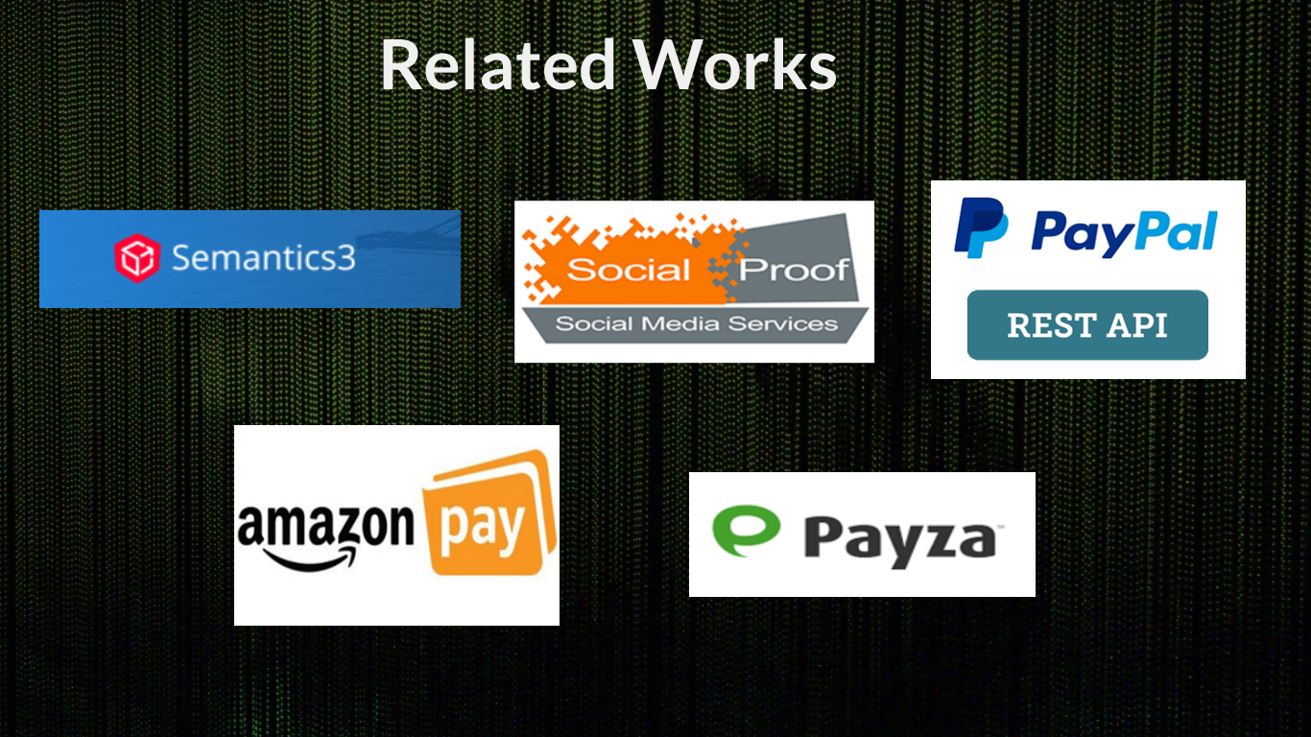
13

Slide 14
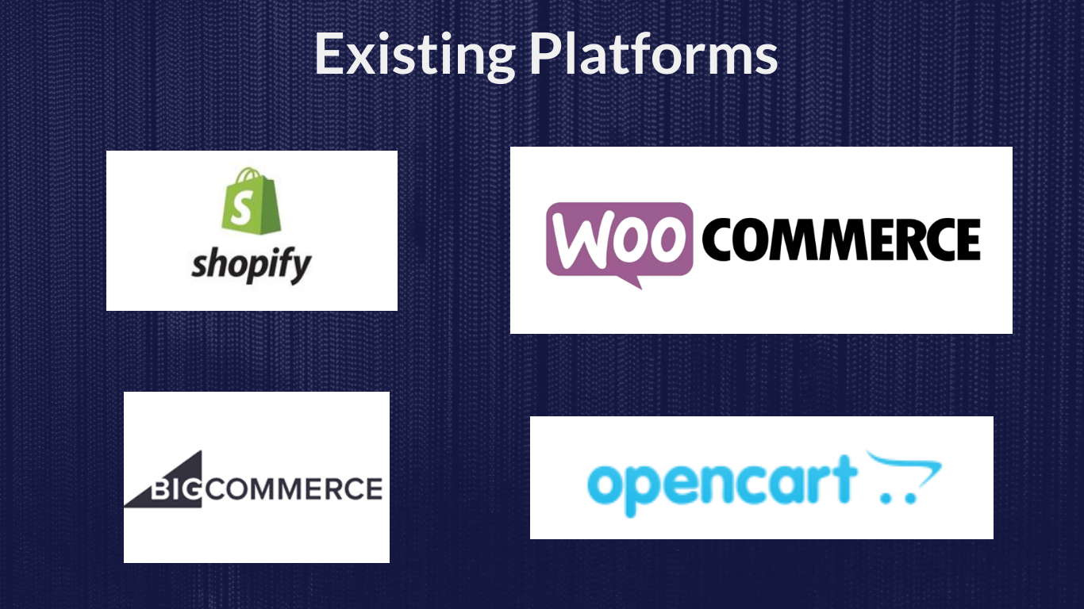
14

Slide 15
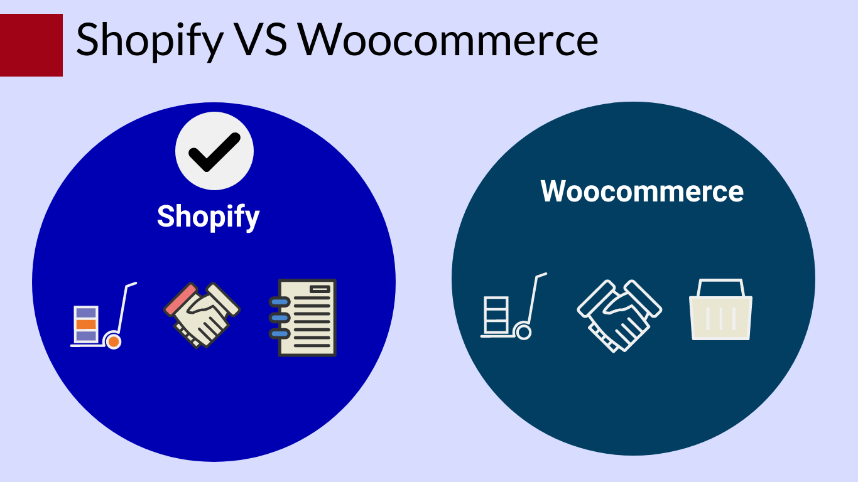

Slide 16
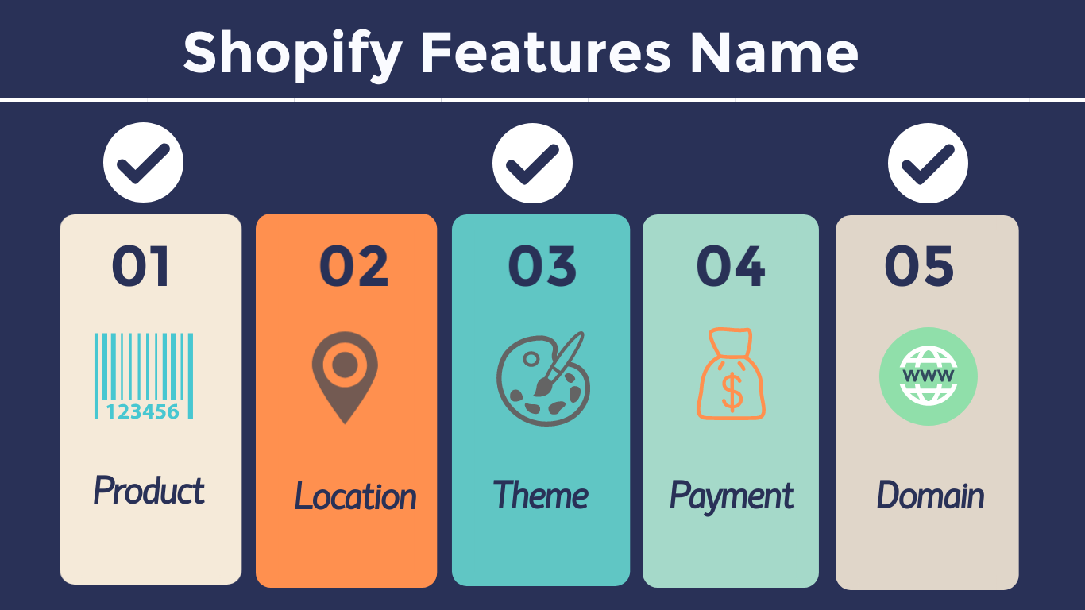
16

Slide 17
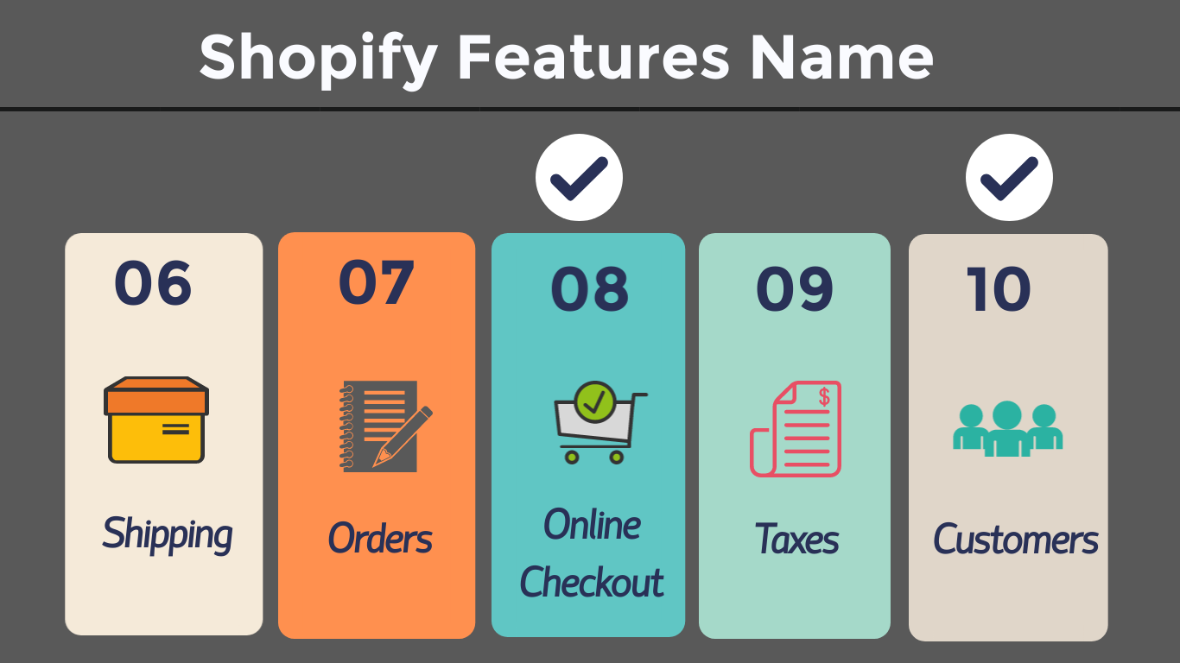
17

Slide 18
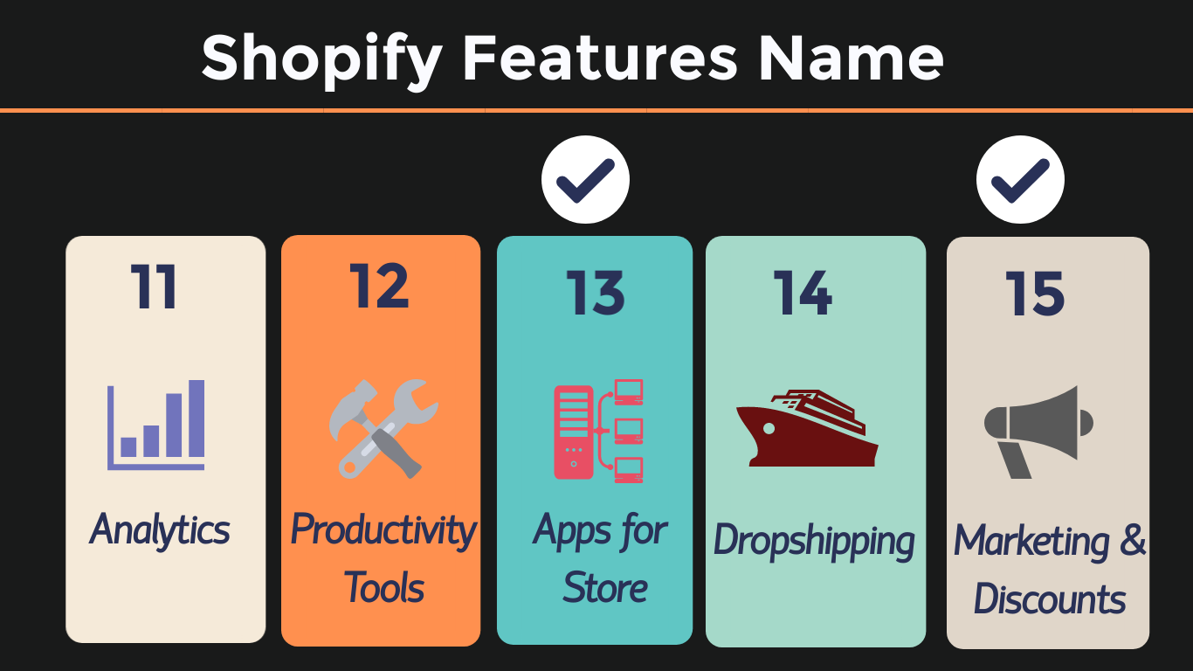
18

Slide 19
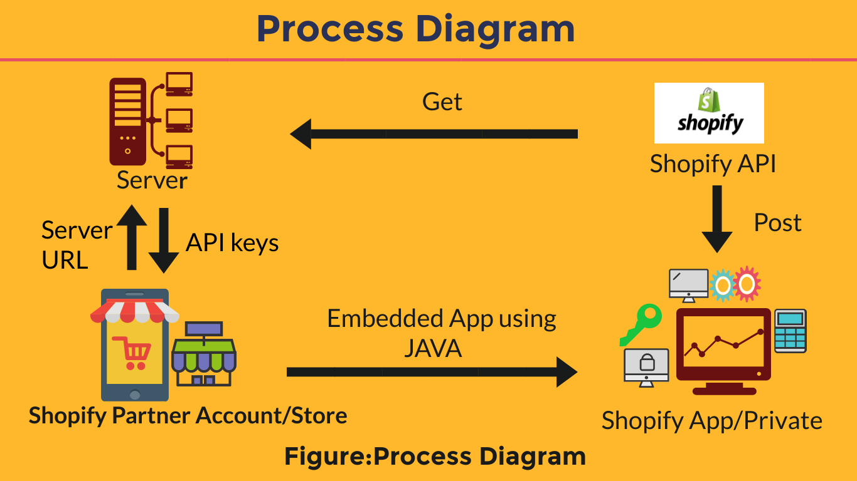
19

Slide 20
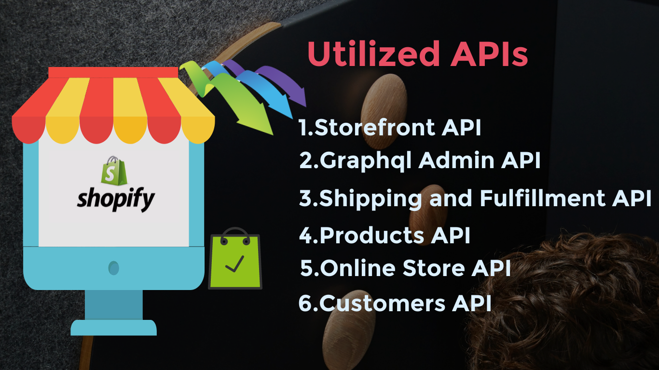
20

Slide 21
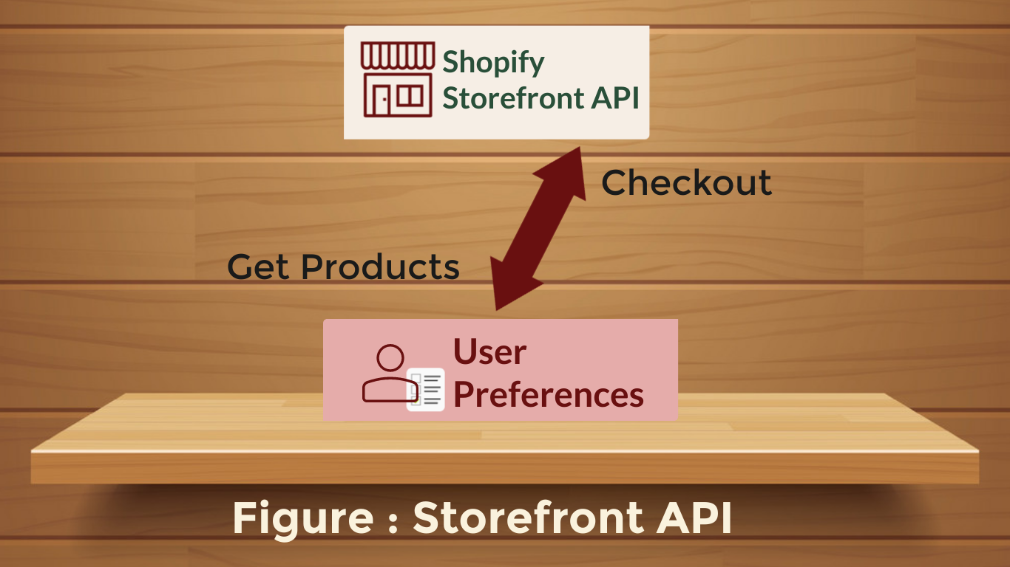
21

Slide 22
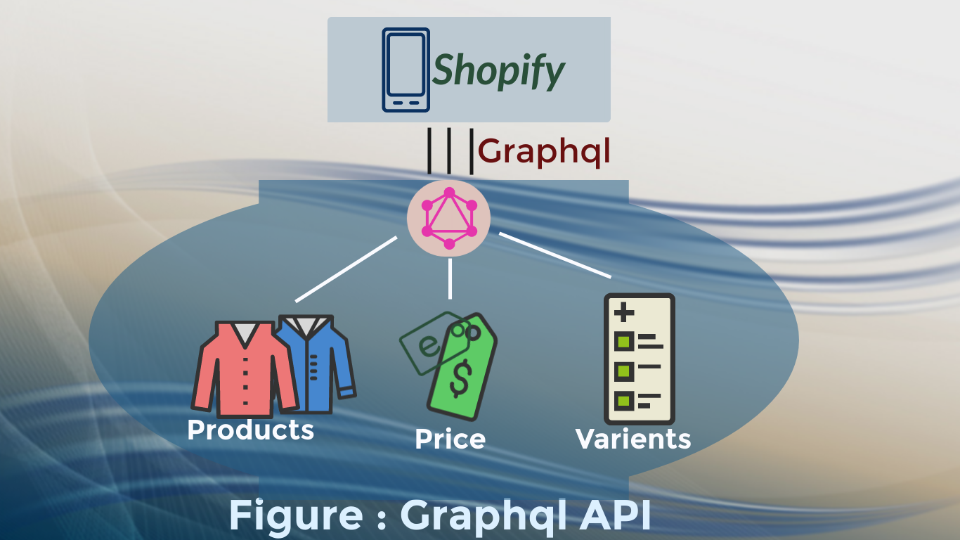
22

Slide 23
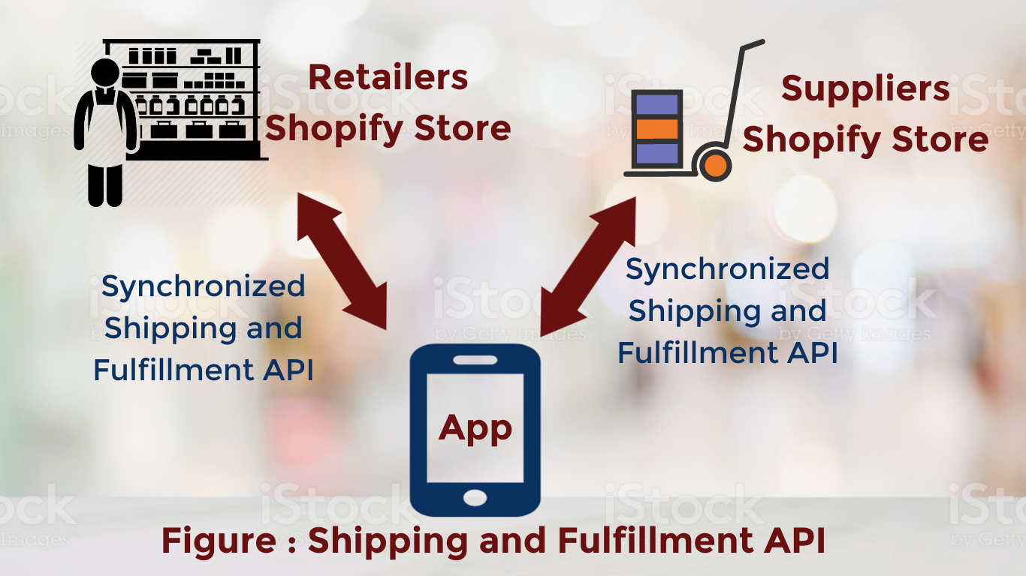
23

Slide 24
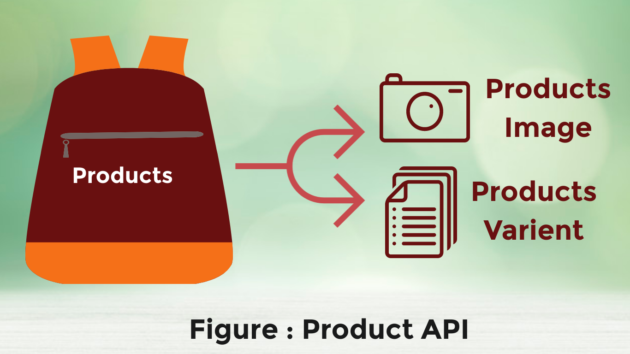
24

Slide 25
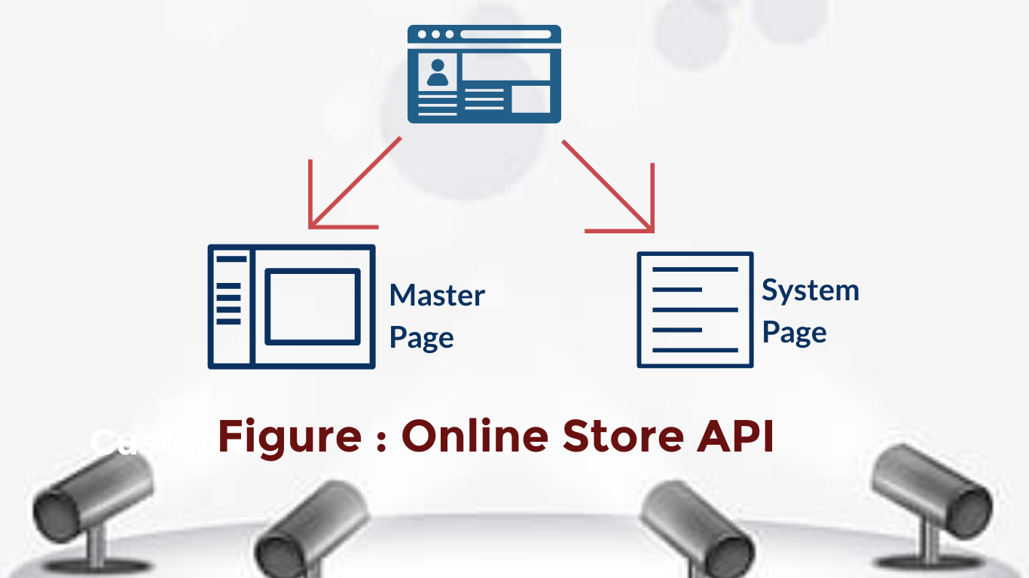
25

Slide 26
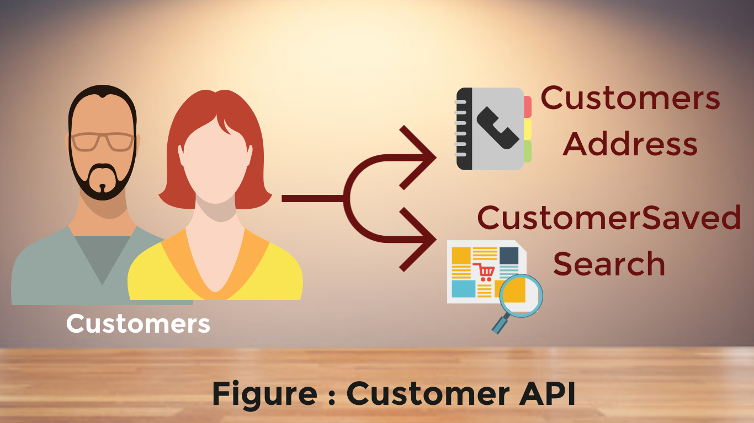
26

Slide 27

27

Slide 28

28

Slide 29

29

Slide 30

30

Slide 31


Slide 32
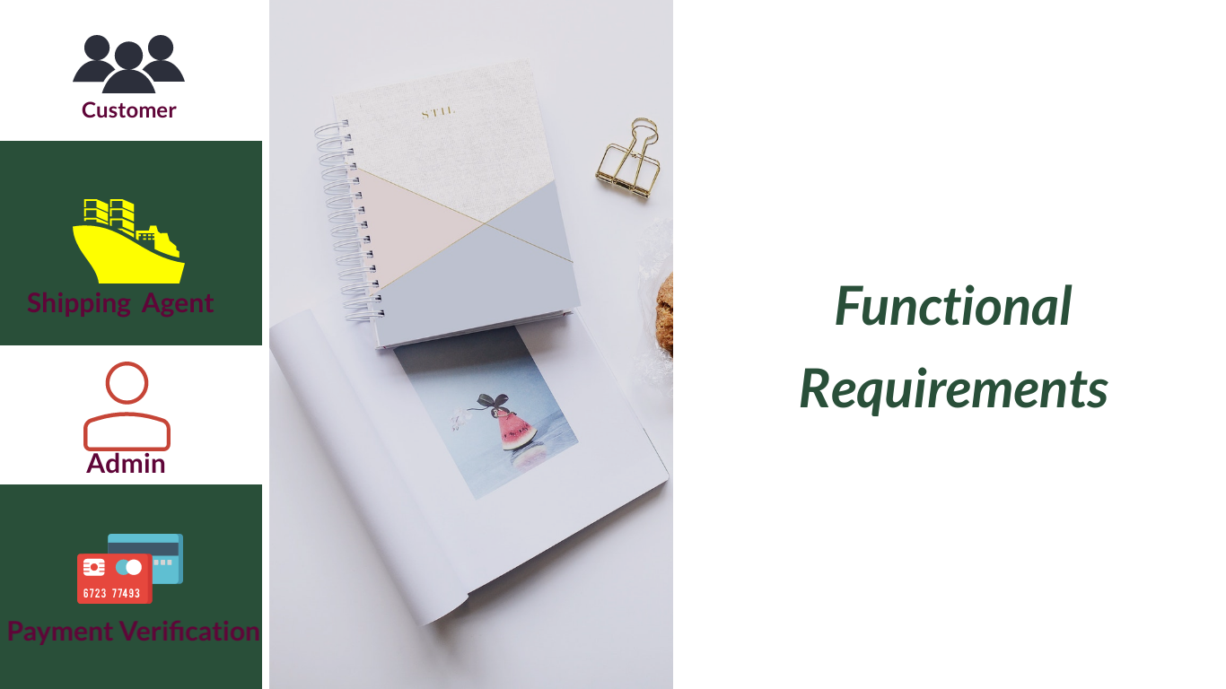
32

Slide 33
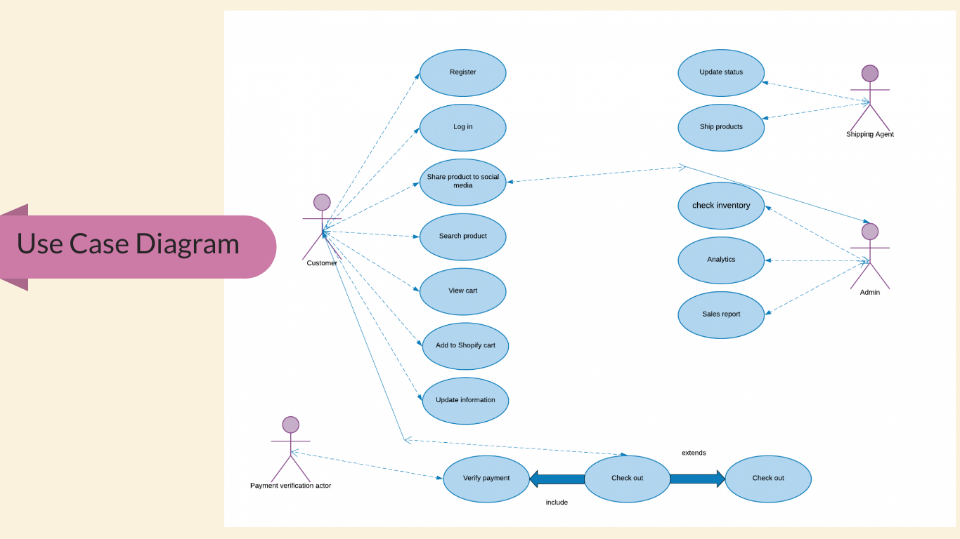

Slide 34
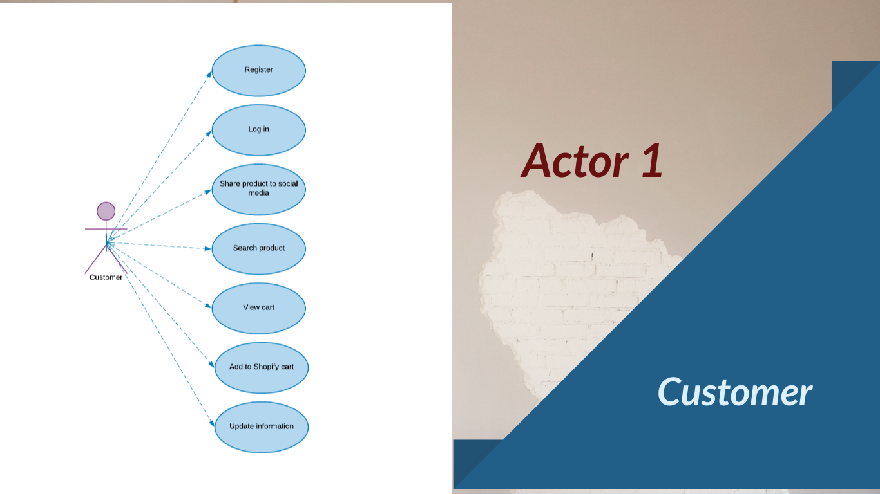

Slide 35
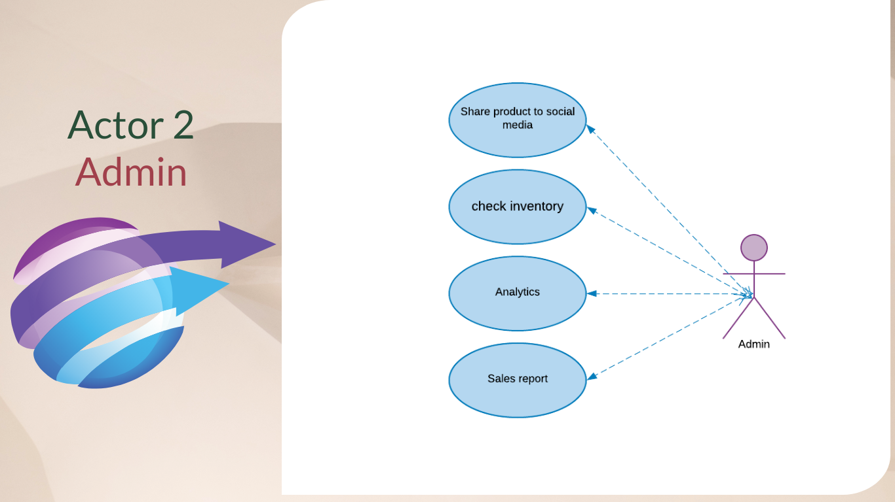

Slide 36
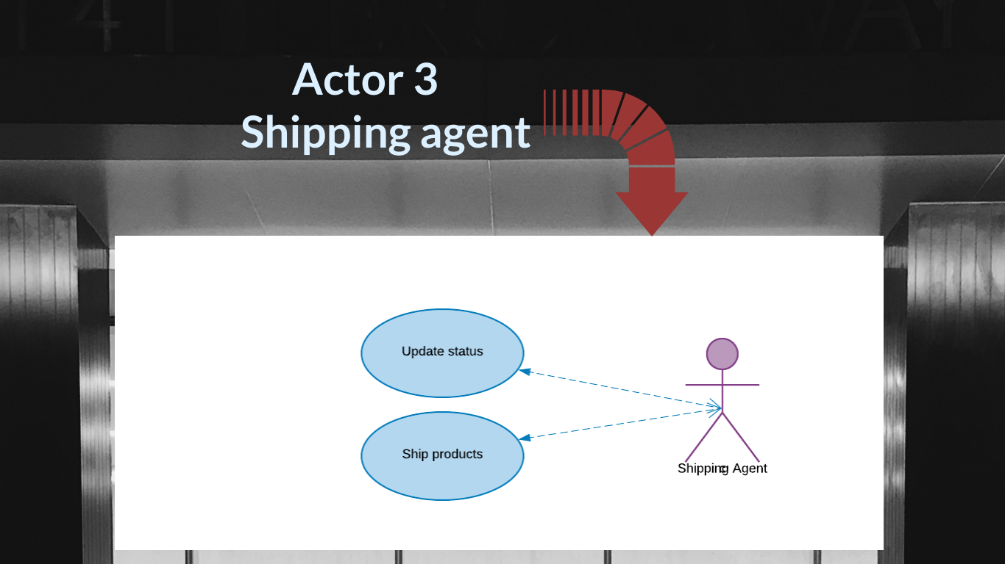

Slide 37
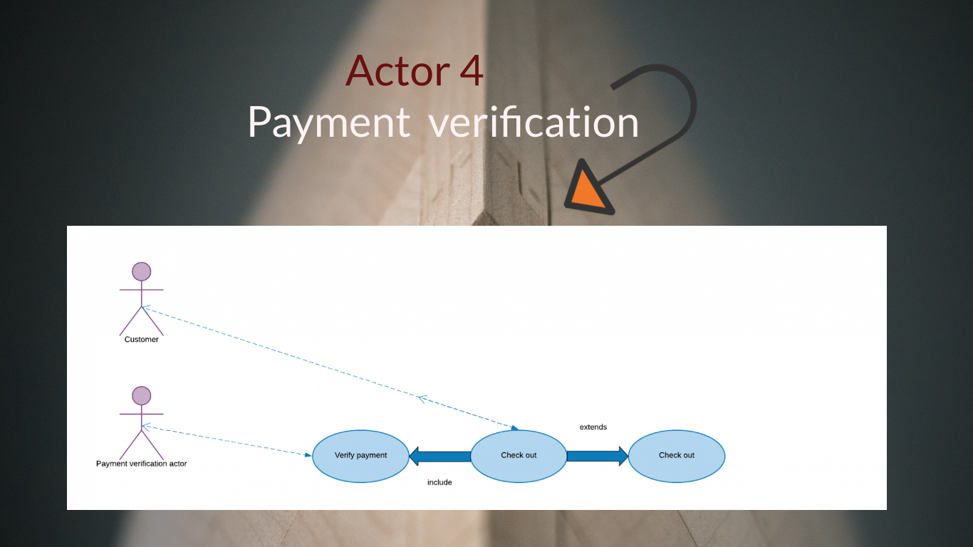

Slide 38
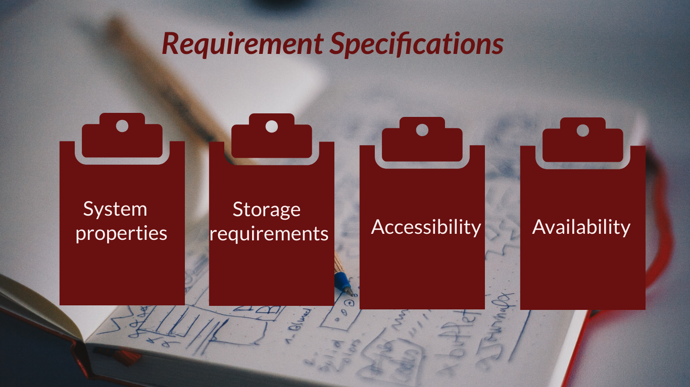
38

Slide 39
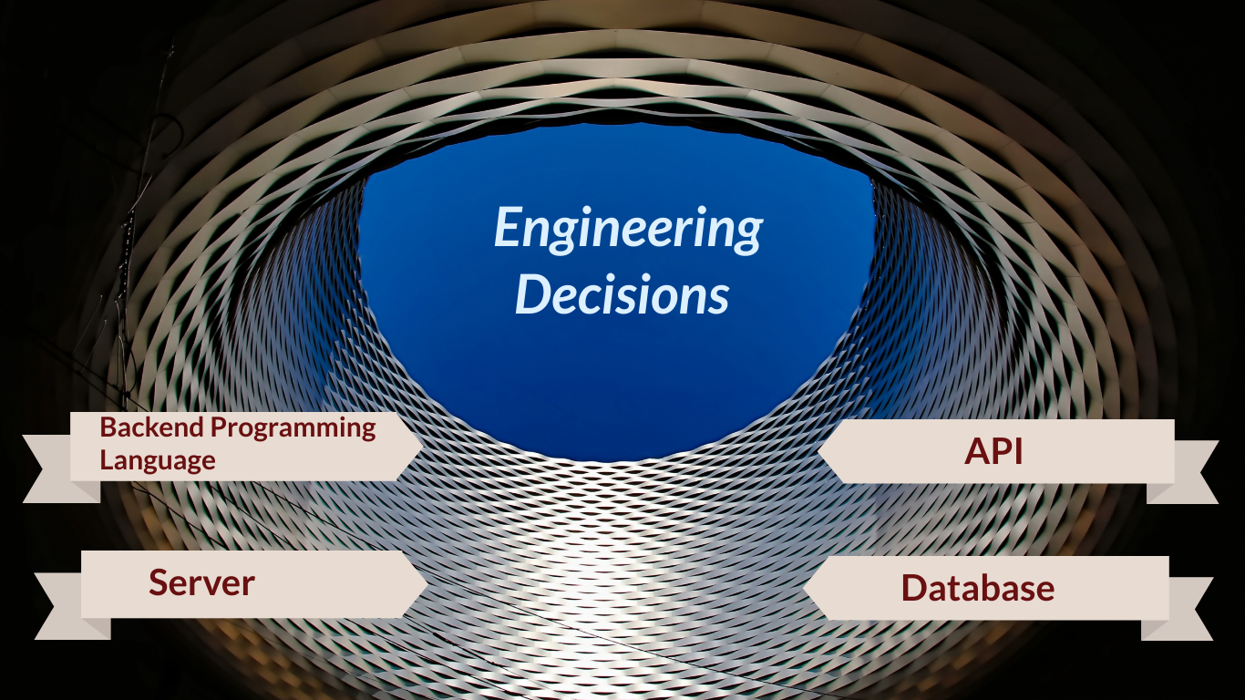

Slide 40


Slide 41


Slide 42
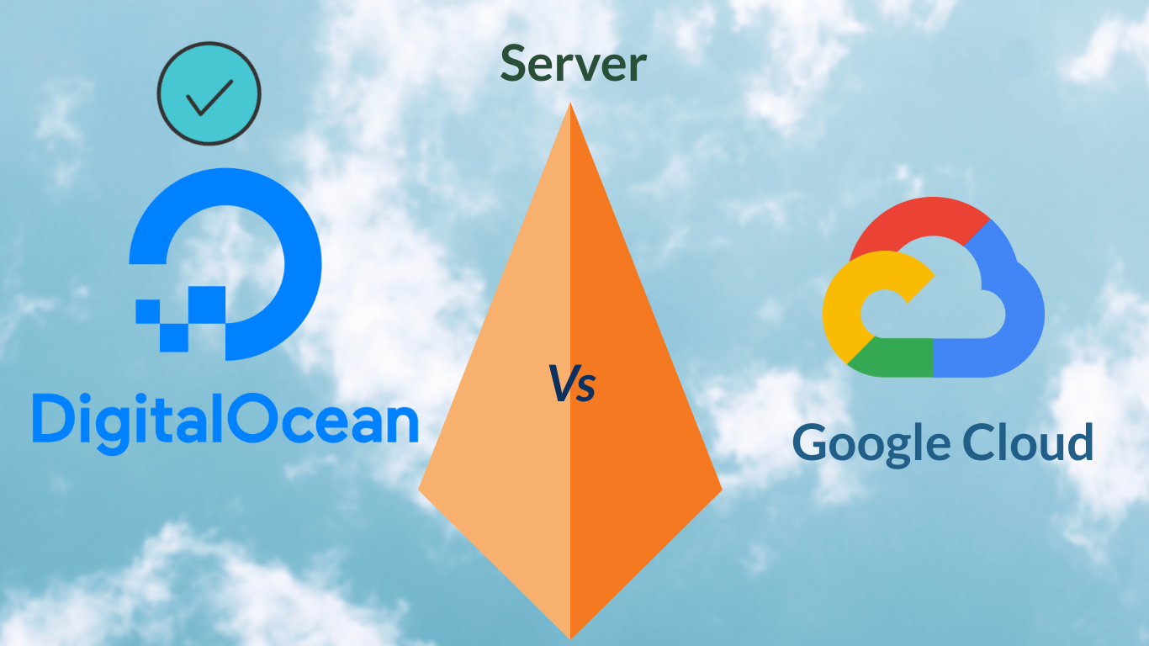

Slide 43
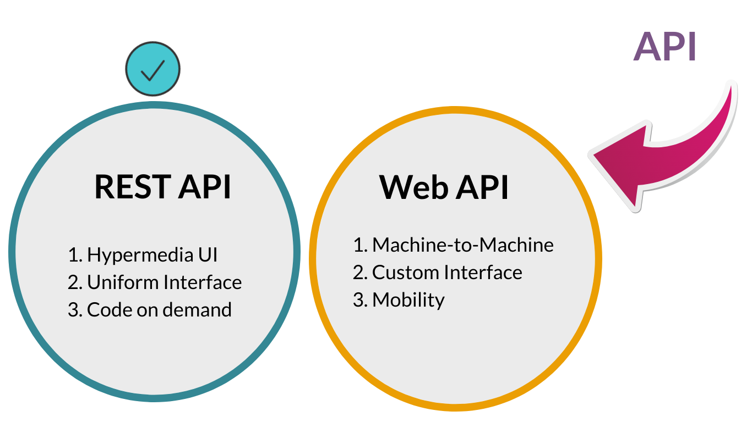

Slide 44
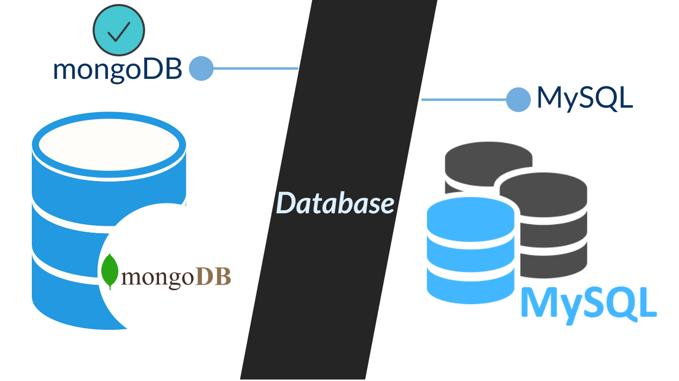

Slide 45
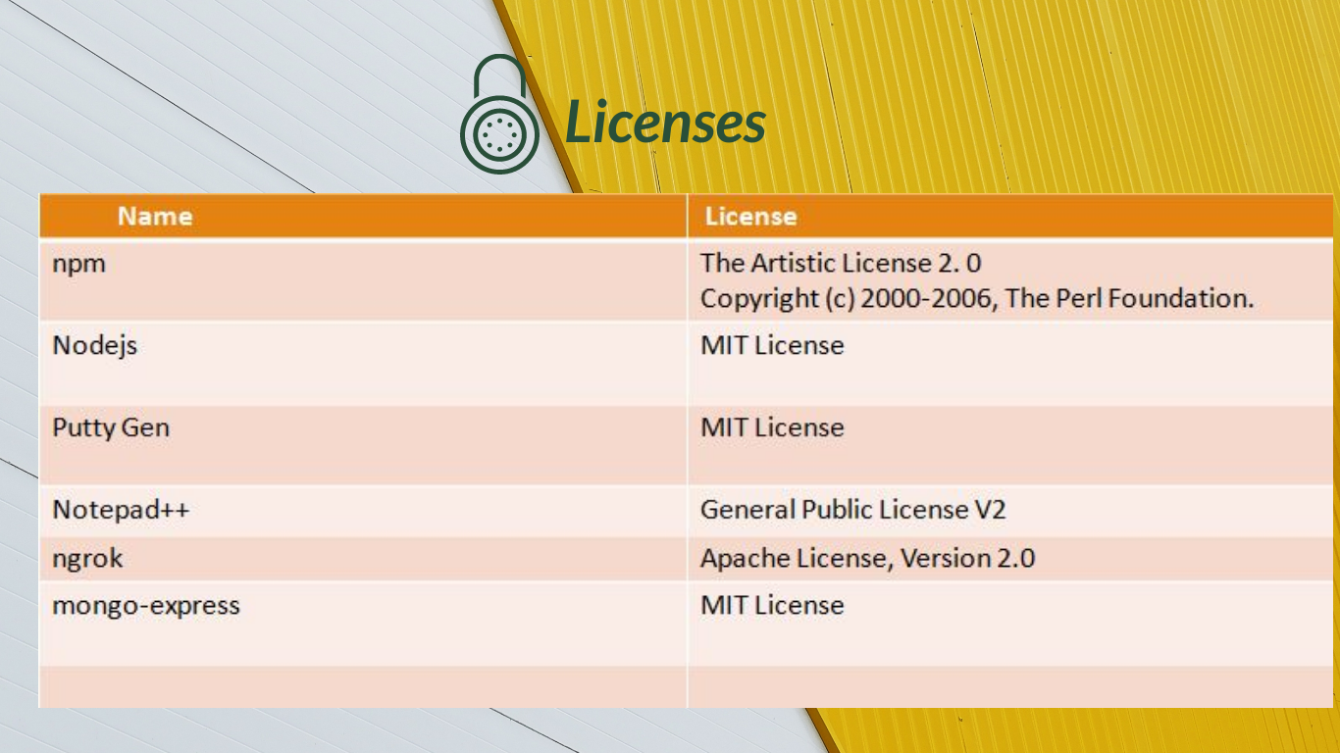

Slide 46
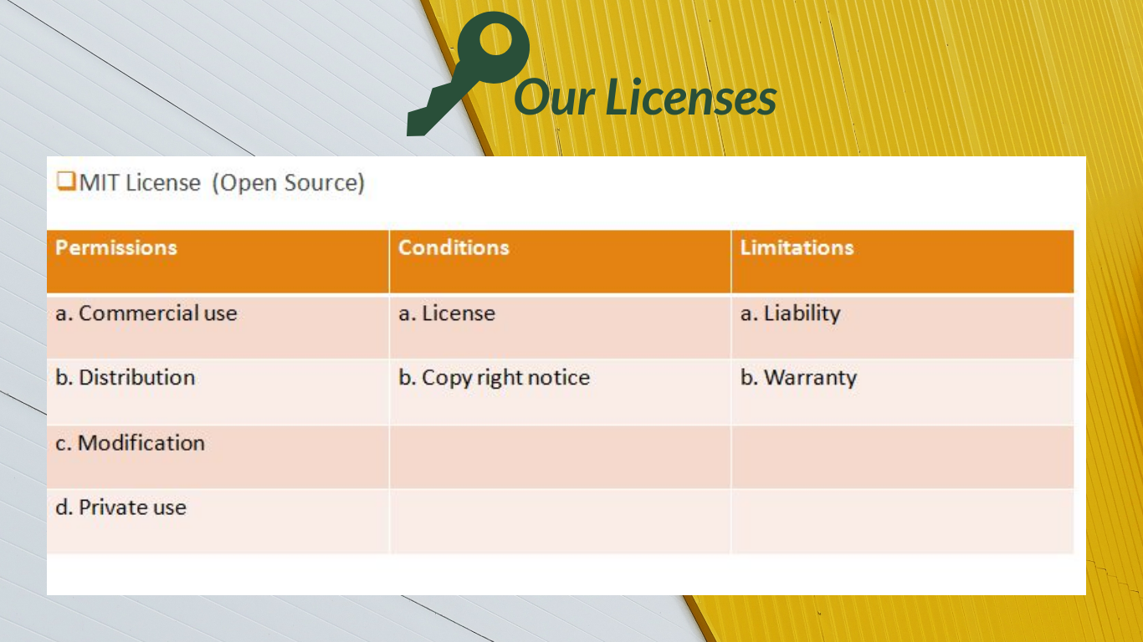

Slide 47
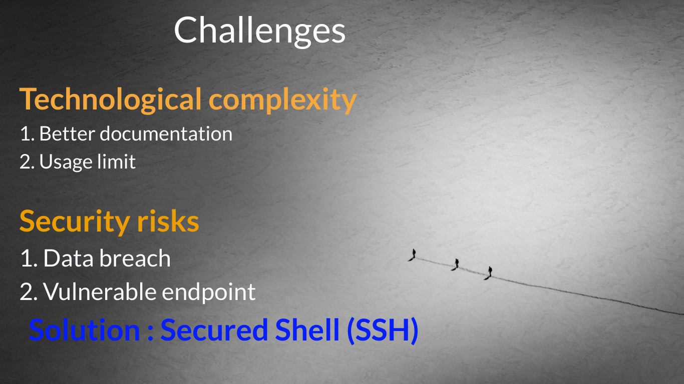

Slide 48


Slide 49


Slide 50


Slide 51


Slide 52


Slide 53
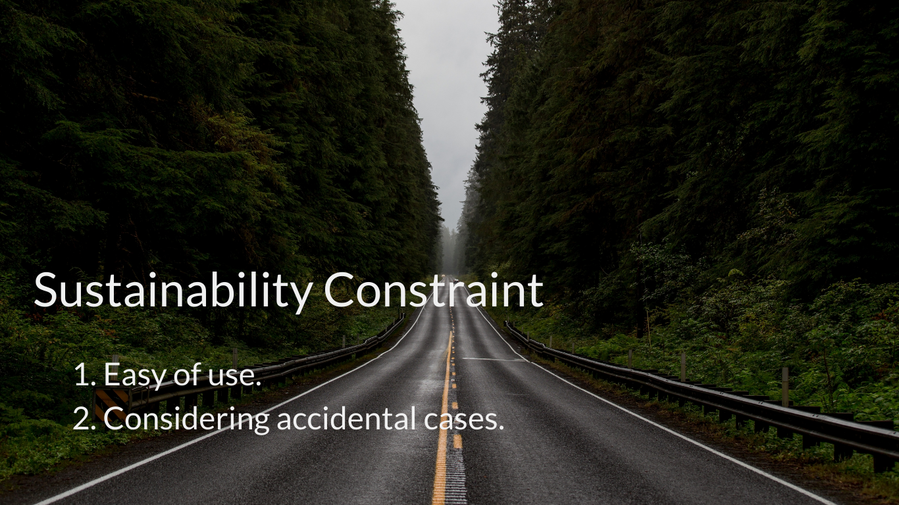

Slide 54


Slide 55
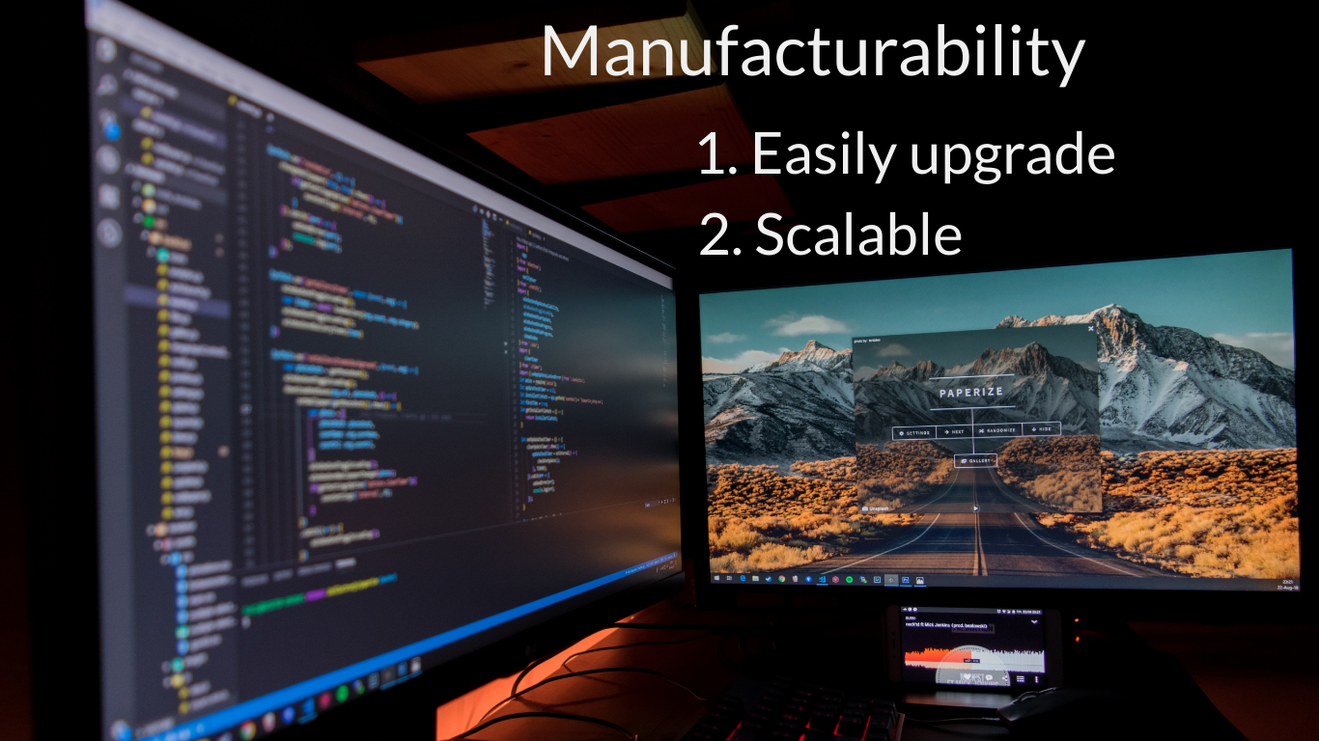

Slide 56
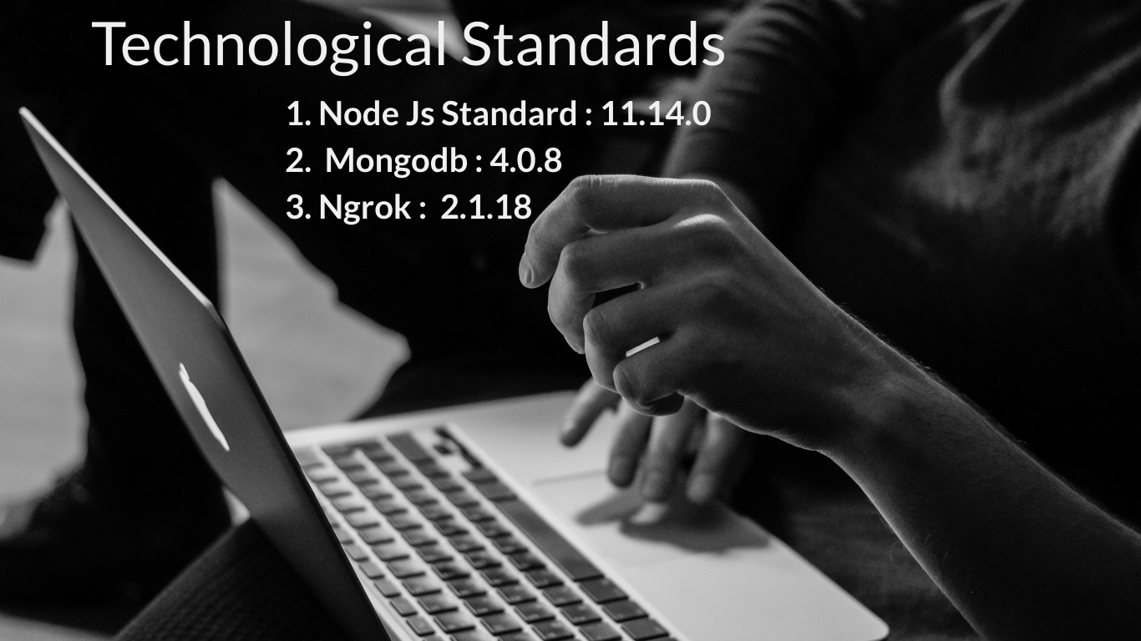

Slide 57


Slide 58


Slide 59
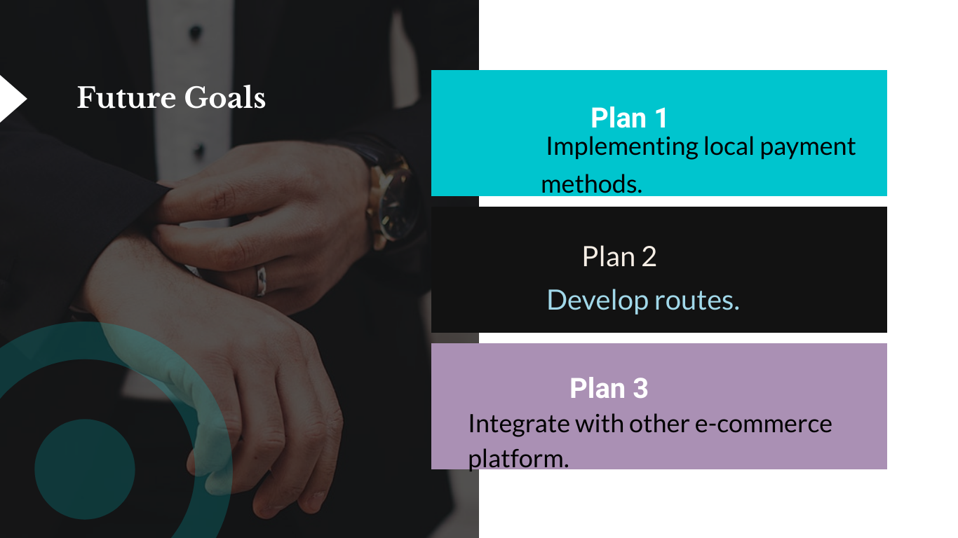
59

Slide 60


